Slide 1


Andy Baker
President and Co-owner, AndyMark, Inc.

Slide 2

BSME, University of Evansville
1992-2007, Delphi Corporation
1998-today, FRC Mentor (teams 45, 3940)
2003, Championship WFA
2004, co-founded AndyMark, Inc.
Co-founder:
  IRI, Indiana FIRST, Championship Conferences, WFA committee
FRC event volunteer (inspector, referee, etc.)

Slide 3

Review History of FRC
Give Lessons Learned
Point out “Inspirational Moments”
Highlight Best Practices
Give credit where it is due

Slide 4


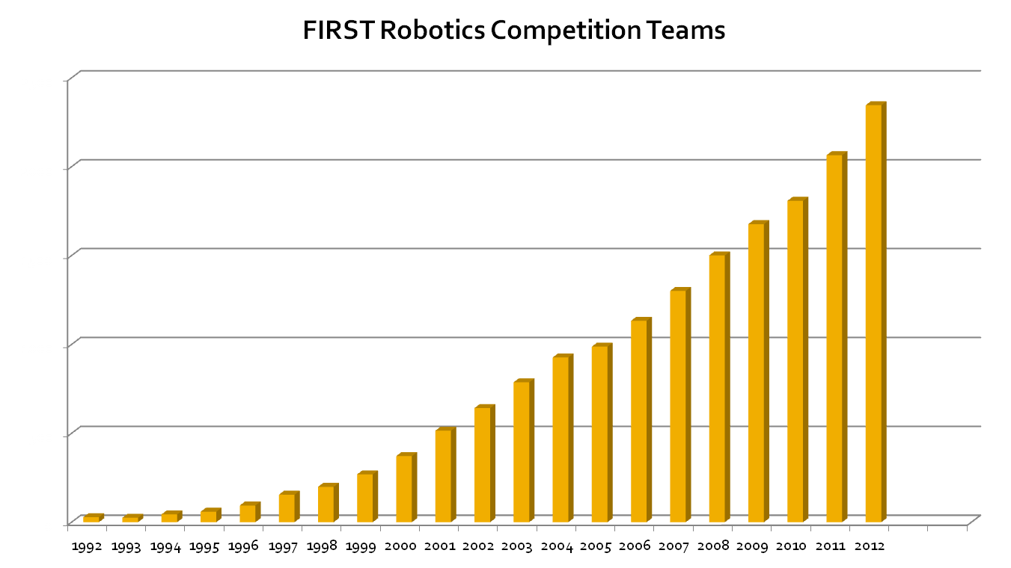

Slide 5

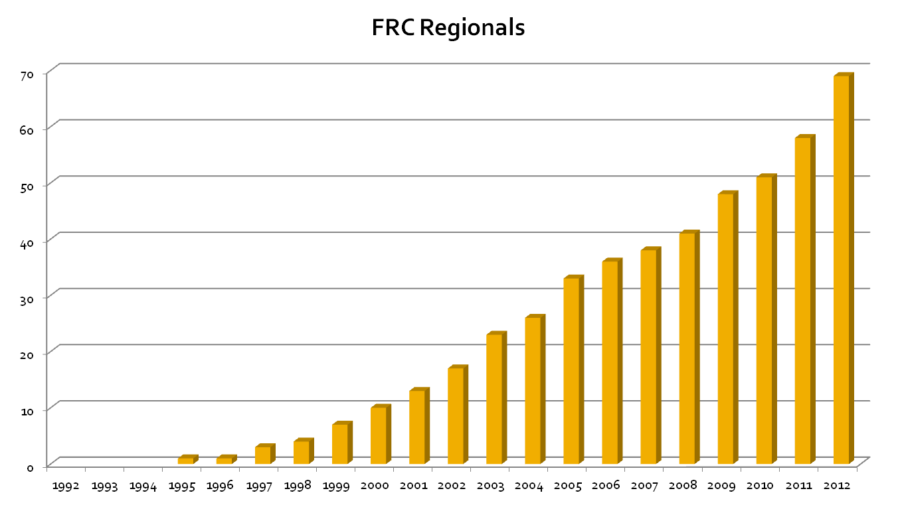

Slide 6

1992: Maize Craze
  tennis balls in corn, 1v1v1v1, tether
1993: Rug Rage
  soccer balls on the floor, low & wide ‘bots
1994: Tower Power
  tossing soccer balls, 1v1v1
1995: Ramp & Roll
  large balls, goal post, continuous scoring
1996: Hexagon Havoc
  large & small balls

Slide 7
1997: Toroid Terror
  inner tubes, rotating tree of pipes, detaching parts
1998: Ladder Logic
  large balls, jungle gym, HP scoring
1999: Double Trouble
  alliances, king of the hill, floppies
2000: Co-opertition FIRST
  kickballs & hanging bar, de-scoring
2001: Diabolical Dynamics
  4 vs 0, large balls, balancing ramp, time bonus

Slide 8
2002: Zone Zeal
  soccer balls, tug of war, gear changing
2003: Stack Attack
  Auto-mode, tote destruction, king of the hill
2004: Raising the Bar
  lg & med balls, collecting, shooting, hanging
2005: Triple Play
  3v3, vision, lift systems, kit drive, AM
2006: Aim High
  Auto-mode ruled, accurate shooters

Slide 9
2007: Rack ‘n’ Roll
  Specialization, Fast lifts, ramps
2008: FIRST Overdrive
  Auto-mode, fast robots, hurdling, IR board
2009: Lunacy (final game – alt video)
  New cRIO system, mandated Rover Wheels on Regolith
2010: Breakaway
  Soccer ball control, hanging, large bumps

Slide 10

1998-99: Don’t give up on good designs
2000-02: Look at the game differently
2003: Plan for automode – is it worth it?
2004: Be very good at 1 thing, at least
2005: KISS – simplicity wins
2006: Make good prototypes
2007: Put-a-side
2008: “Good enough” is only OK
2009-2010: Robots must continuously improve to be very competitive at Championships

Slide 11

1992: Clinton Nypro’s ball harvester
1994: P&G Sunny Delight shooter
1997: Beatty Hammond 4-bar arm
1998: TechnoKats roller claw
1998: ChiefDelphi swerve
2000: ChiefDelphi robot
2000: TechnoKats shifter published
2001: Beatty Hammond system

Slide 12
2002: Kingman lifter vs Beatty walker
2003: Wildstang automode
2004: WPI bar climbing automode
2004: TechnoKats reach over arm
2004: Drivetrain feedback: many
2005: 330 arm simplicity
2005: Pink team’s telescoping arm
2005: Team 60 & 254 capture wheel

Slide 13
2005: Kit gearbox & Kit Chassis
2006*: 217 turret shooter
2007*: 910 automode,
2007*: 6 keeper at IRI
2007: 968 & 254 Aluminum shifter
2008*: 1114 hurdler
2008: multi-line automodes
2009: Ball storing and sorting
2010: 469 ball sorting, strong man lift

Slide 14

Put-a-side: Bill Beatty & Team Hammond (71)
Finish early: debug start in week 4
Break it early
Use ALL resources on main concept
Drive by end of week 2, but weigh it down!
Build 2 robots:
  Top 10% teams do this
“Good enough” is simply not
Practice, practice, practice
Checklists, checklists, checklists

Slide 15

1st Shifting transmission: team 20 (1997)
1st Swerve drive: team 47 (1998)
1st Shift-on-the-fly transmission: 45, 60, 302 (2002)
1st Omni-wheel: Team 67 (1998)
1st Mecanum wheel: Team 357 (2004?)
1st Technical design team sharing: Team 45 (2000)
Behind the Design
  Vince Wilczynski and Stephanie Slezycki

Slide 16

Questions?

